Slide 1
5 reasons why the Early Help/Family Hub Practitioner Programme
meets your workforce needs.

Slide 2
1
It meets latest policy and practice
This is a comprehensive 4 day skills based training programme specifically developed for the Family Hub and Early Help workforce.
We have trained over 14,100 practitioners and managers across the Country.
We created this course to meet the changing needs of practitioners who need to work across the age range and with all family members to achieve sustainable outcomes through multi-agency or integrated working.
Some staff need new skills. Others want to understand how to adapt their skills to new context and clients. Most want to understand how their role fits with strategy, other partners and local outcome plans.
We have been continually developing this course which we know meets current workforce needs.

Slide 3
2
It’s based on what the sector needs
We have been delivering this across the Country to many areas and it is built on what we know areas need and what we know works to create an effective workforce for those working with children and families. The course:
equips learners with understanding, skills, ability and confidence work effectively with children, individuals and families with both complex and emerging needs
provides a programme which is fit for purpose and meets the current workforce needs
gives skills based training which takes into account the differing role that practitioners hold
meets the need of a multi-agency partner workforce
provides training in essential areas which have been identified as skill shortages in practice including practitioners effectively addressing concerns, holding difficult conversations and bringing about sustainable change
a flexible programme with an opportunity to tailor content to meet local needs by using local forms, internal processes etc.

Slide 4
3
It’s comprehensive
We have developed the content and style from our experience and feedback from local authorities, partner agencies and past participants. We have worked really hard to get it right and we can adapt this to meet your specific needs.
If families have skilled and resilient staff working with them, their chances of achieving positive outcomes are higher.
The course is focused around 3 modules:
Effective Engagement and communication
Skills to complete Family and individual Assessments, Tools and Planning
Supporting family members towards independence and self reliance

Slide 5
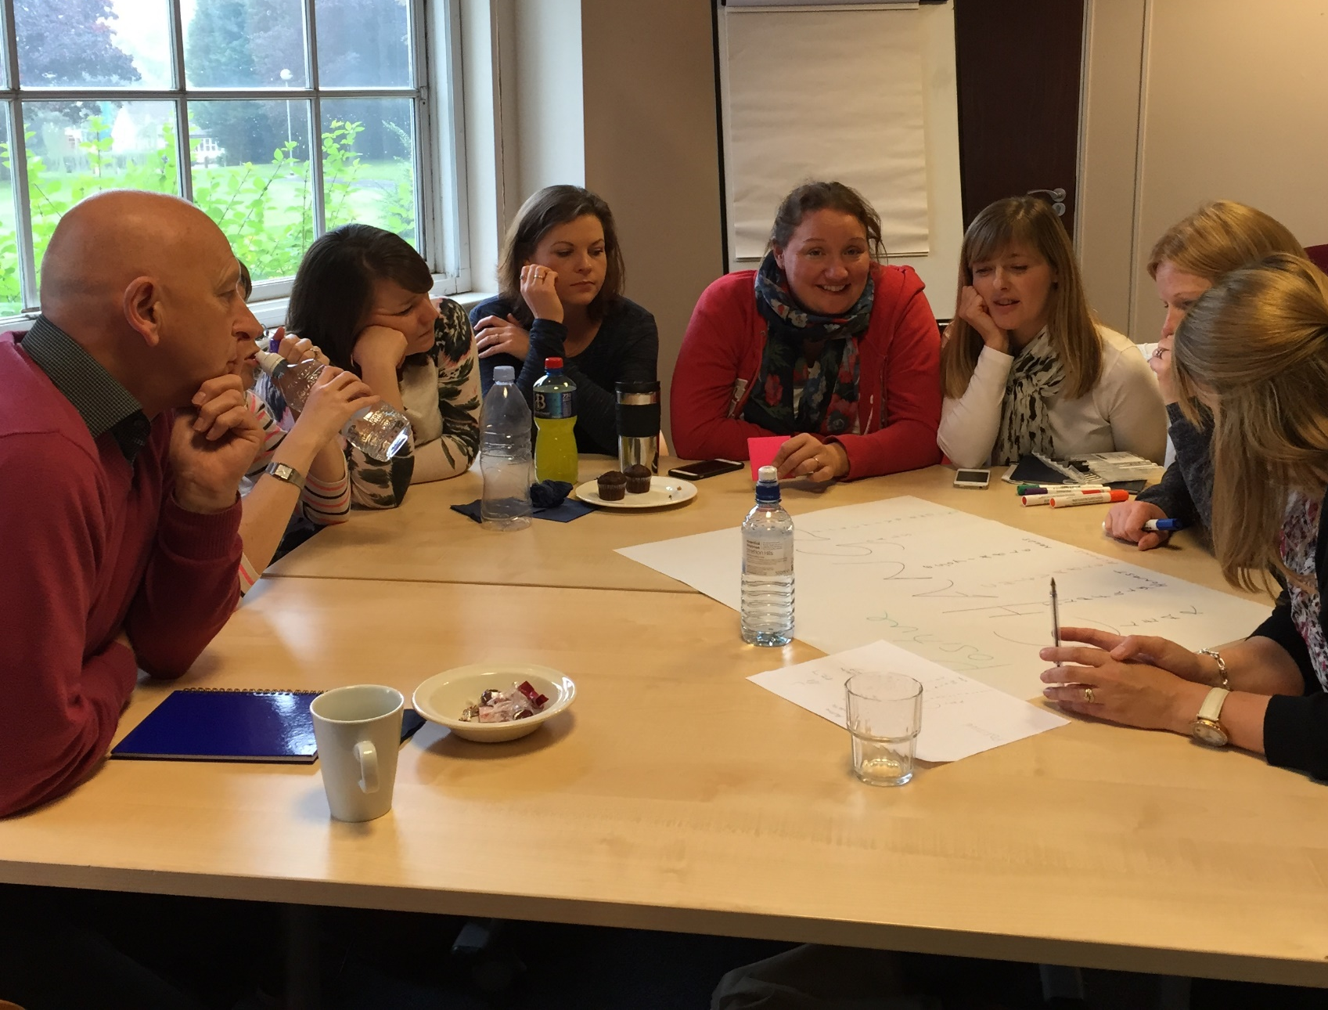
4
Our Approach
We are strengths based and flexible. We are committed to getting it right for you and all learners – regardless of learning style, role or home agency. We use a range of teaching methods – group or paired discussion, visualisation, take aways, videos, role play etc. to create an interesting and fun. We have created our own interactive videos to bring training to life.
We have been running this successfully both face to face and on a virtual basis (over half day sessions).
The course is backed by a comprehensive individual workbook and reflective log to ensure learning is embedded into practice. This is a unique resource built on knowledge and feedback of professionals being able to make links from the taught sessions to their own practice. This can be shared in supervision and case consultation sessions as a resource and personal development tool.

Slide 6
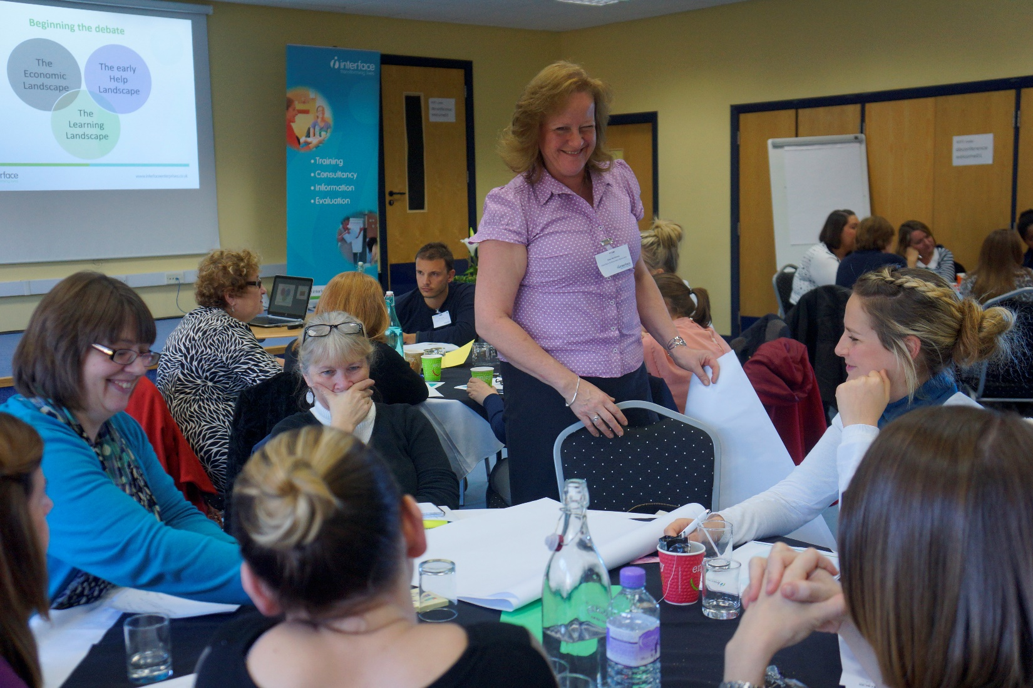
5
Delivered by a Quality Provider
Interface is a national provider of support for those working with children, individuals and families. As a value’s based organisation, we wanted to do what’s right, which is why we have created this course and continually update it and tweak it to meet your precise needs.
Our credibility is solid - we have trained over 12,800 practitioners and managers over the last 11 years. We have developed an excellent reputation for quality provision and become a key provider of training for those working with children and families.
You are in good hands – we know that our training leads to improved practice - Just look at our website to see what people say about us!
We hold regular meetings with our trainers to share good and current practice as well as to reinforce our high quality expectations. As a niche, value’s based organisation we want to do what we think is needed, which is why we created this new qualification. Interface is led by Wendy Weal, who was previously
Our trainers all have years of direct experience of working with whole families in a multi-agency setting. They come from a range of backgrounds including housing, social care, education, early years, youth offending and housing. They really understand the complexities of supporting sustainable change for families .… and how rewarding it is when there is success!

Slide 7
Commissioners – What will this give you? Our experience suggests that your workforce need and appreciate: a practice based programme which recognises their role and builds knowledge understanding and skills needed to carry it out investment in them as an individual and as a team time to reflect and understand what works and why an opportunity to try out new approaches - putting skills into practice the opportunity to consider themselves and the impact the work has on them as workers We know from experience that this creates: a more effective and reenergized workforce a supportive and open minded workforce with the ability and energy to bring about change more effective case working and less time with cases being stuck/blocked a more resilient workforce – able to manage their role and support others
Commissioners - what will the course give you?

Slide 8
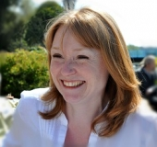
Thanks for reading. What next?
I hope that you are interested in our Family Hub/Early Help programme.
We are really pleased that we consistently receive excellent feedback on this and our flexibility and supportive approach in delivering it. We are passionate about supporting you to make a real difference and I know that comes across in our training.
I am sure you will have some questions for us. Please pick up the phone or send me an email so that we can start helping you to make a real difference to the lives of the vulnerable children and families.
Wendy Weal
Managing Director
01603 251730
wendy.weal@interfaceenterprises.co.uk
www.interfaceenterprises.co.uk
25b Henderson Business Centre
51 Ivy Road
Norwich
NR5 8BF

