Slide 1
Leadership Development Programme
Overview

Slide 2
Why a leadership programme?
Managers and leaders need to have good relationships between themselves internally and with partners externally to meet objectives and achieve outcomes.
They need to influence, engage and work collaboratively with others to maximise resources, reduce overlap, share knowledge and supportively challenge to ensure the right services are provided in the right way.
This programme supports managers to learn about themselves and develop in their leadership/management role.

Slide 3
Our programme is different …
The learning is experiential – this is a development programme, not the same as a taught course.
We create a safe space for everyone to learn about themselves, their strengths and their skills and aptitudes for leadership. Also to appreciate their differences.

Slide 4
Our programme is different …
Participants will develop as individuals as well as in their leadership/management role and jointly following the same journey to meet organisational goals.
They try out approaches and apply their learning to their work environment, reflecting on experiences and practices.
We encourage them to be open and to develop trusting relationships with each other.

Slide 5
What the programme covers:
What is leadership - Differentiating leadership from management, principles of effective leadership, individual, team and organisational leadership theories, relationship management, strategic contexts
Leadership style - values and behaviours, emotional intelligence, personality preferences, leadership styles, influencing, adaptive leadership
Leading for change – change theory and models, engaging others/collaborative advantage and co-production, dealing with resistance
Leading improvement – priority setting, data and quality assurance, developing business cases, self-awareness and insight, influencing strategies, managing up, coaching conversations
Leading people – supervision, team roles, communication styles, feedback, performance management, coaching conversations
And much more!.....

Slide 6
What do participants say?
Transformational!
Every bit of this has been really useful for me in my professional role and I could see the value in my day-to-day work. The delivery was great – thorough and at the right pace.
This hasn't just been a programme it's been a game changer for me.
You made learning enjoyable and great. Cannot praise your competency and ability enough, supportive, your presentation and delivery was lively and informative.
This provided me with the opportunity to reflect on and improve in my practice and always think about what good looks like.
I loved every session, couldn’t wait for the next one. I have learnt such a lot that I have already used in my leadership role. It was well organised, and excellent.

Slide 7
What do participants say are the benefits of attending …
Reflecting on myself, being in a group of people from different areas, building those relationships making connection and building relationships.
A safe space to learn and challenge having the time and space to reflect.
Time to step back and think about how to have impact and develop in role
Understanding myself and recognising me as a good leader, time to reflect on myself as a leader.
Tools I can use to overcome any leadership problems. Networking, learning theories and having the time to put these into practice between sessions.
Building in confidence, opportunity to self-reflect, develop my leadership skills.
Develop self-awareness as well as relationship/partnership development.
Massively increased awareness of self, understanding of others and their roles.
The chance to better understand the big system picture from so many different perspectives.

Slide 8
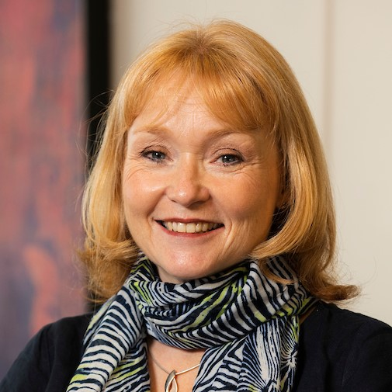
Thanks for reading – what next?
I am sure you will have some questions for us. Please pick up the phone for a no obligation chat or send an email.
Wendy Weal
Managing Director
01603 251730
wendy.weal@interfaceenterprises.co.uk
www.interfaceenterprises.co.uk

