Slide 1
Working Effectively with Young People – Understanding Adolescent Development and Contextual Safeguarding in Families

Slide 2
What’s the need?
In our work across the Country, we see concerns and issues around:
Lack of skills/support/provision that enables practitioners to feel confident to manage adolescent risk.
Local authorities spending huge amounts of money on out of area looked after placements for adolescents where the family unit has broken down.
An increase in Childhood Sexual Exploitation (CSE), Criminal Exploitation (CE), substance misuse, adolescent on parent violence and mental health issues.
Decreased services available for young people in the community to meet adding pressure on family services.
Staff sharing that it is increasingly difficult to engage the young people/adolescents as part of a wider family plan.
The risk factors for young people are spiralling. Practitioners are telling us that they are not feeling confident in how to respond.
We have created a TRAINING programme and WIDER SUPPORT offer specially designed to help address these issues.
Decreasing budgets, resulting restructures, changes in agendas and role responsibility has highlighted a gap which we believe is having a significant effect on timely outcomes for children and young people, increasing risk whilst ultimately costing more.

Slide 3
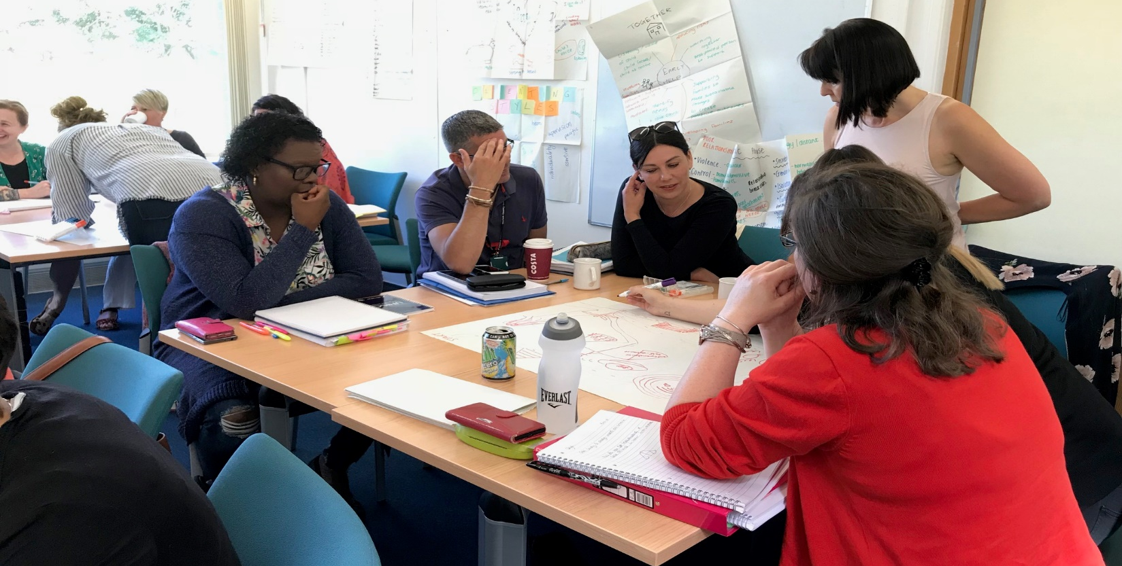
Training
Our training meets latest research, policy and practice
We have designed a training package that enables participants to build their knowledge and understanding around theories of child and adolescent development, learn from recent research into contextual safeguarding, teenage development and trauma informed practice. We will share best practice, direct working tools and interventions on how to use these in everyday practice.
This is a comprehensive 3 day skills based training programme specifically developed for the Young Person and Adolescent workforce.
We will ensure that staff leave the training feeling more confident and skilled about how to apply new learning and opportunities to reflect into their practice in order to support, hold and manage risk.

Slide 4
Training
It’s comprehensive and adaptable
We have developed the content and style from our experience and feedback from local authorities, past participants and partner agencies. We have worked really hard to get it right and we can adapt this to meet your specific needs.
The course is focused around 3 modules:
The foundations – Understanding young people, adolescents and risk - the underpinning and essential knowledge around working with young people covering the foundations of relationship building. We provide an understanding of teenage brain development, the impact of trauma and early experiences. We share tools, research and ideas around what helps in practice and identify why some of our interventions with young people are less successful.
Understanding and managing risk Staff will feel confident in assessing risk and indicators, have a range of tools to use in practice to support conversations with young people and families and build stronger multi-agency working relationships.
Theories, Tools and Practical Application to support intervention This final day supports learners to work confidently and competently with young people. The day will focus on practical theories, their application and how they can be embedded into individual and family support. This support the ‘What Now’ element of the programme.

Slide 5
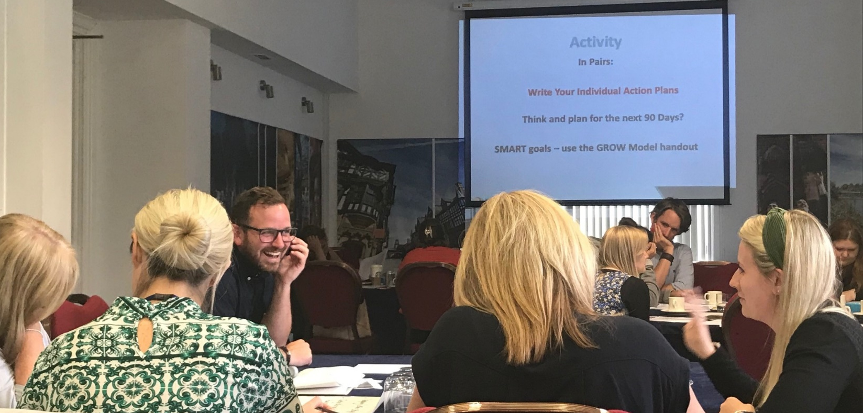
Training
It’s suitable for a wide range of practitioners
If young people have skilled and resilient staff working with them, their chances of achieving positive outcomes are higher.
It is suitable for a wide range of practitioners who work directly with young people as a part of a wider team around the family including:
Support staff in schools
Voluntary sector youth workers
Social work teams
Housing officers working with young
people and families
Police & probation workers
Local authority youth offending workers
and managers
Community safety
Heath staff from CAHMS hospital settings
and NHS safeguarding leads
Early Help and whole family workers in
Context of the Troubles Families programme
‘The trainer has been one of the most memorable and skilled trainers I have come across. Memorable for her capacity to instantly build friendly and supportive relationships with all of the cohort and her ability to make everybody feel comfortable at the training, within a couple of hours on the first day it was clear how much knowledge and passion she holds’.

Slide 6
Wider Support - Supporting children’s services leadership teams to understand and apply contextual safeguarding
We also have a highly experienced team who are able to support systems, processes and leaders around:
Leading and managing the offer of services for youth offending/family support/etc. in the context of recent research on systemic therapies, contextual safeguarding and adolescent development
Understanding the vision, principles and workforce requirements for addressing issues of the changing risks to young people
Developing the data systems to better understand the profile of cohorts of young people and their exposure to risks
Understanding the support, supervision, and reflective practice approaches needed by managers
Improving multi-agency working including quality of risk panels, strategy meetings and information sharing
This would be a mixture of training, action learning sets and consultancy support. We will create a bespoke support package.

Slide 7
Quality Provider
Interface is a national provider of support for those working with children, adolescents, individuals and families. As a value’s based organisation, we want to do what’s right, which is why we have created this programme and continually update it and tweak it to include research, best practice and deliver it to meet your precise needs.
Our credibility is solid - we have trained over 10,800 practitioners and managers over the last 8 years in both skills based and accredited courses.
We have developed an excellent reputation for quality provision andhave become a key provider of training and support. We also have ISO 9001 demonstrating our commitment to quality provision and management.
You are in good hands – we know that our training and support leads to improved practice - Just look at our website to see what people say about us!

Slide 8
Thanks for reading. What next?
I hope that you are interested in our the support we offer around Working with Young People Adolescents and Safeguarding.
We are really pleased that we consistently receive excellent feedback particularly around our flexibility and supportive approach. We are passionate about supporting you to make a real difference and I know that comes across in our training and consultancy support.
I am sure you will have some questions for us. Please pick up the phone or send me an email so that we can start helping you to make a real difference to the lives of our vulnerable young people.
Wendy Weal
Managing Director
01603 251730
wendy.weal@interfaceenterprises.co.uk
www.interfaceenterprises.co.uk
25b Henderson Business Centre
51 Ivy Road
Norwich
NR5 8BF

